Slide 1
Removing the Constraints that Limit Experiential Learning as a Catalyst for Global Impact
A HEDs Up Session for the AAC&U Annual Meeting
Global and Civic Learning

Slide 2
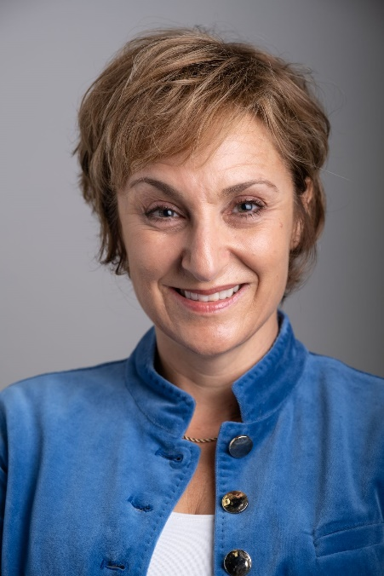
University at Buffalo Experiential Learning Network (ELN)
Mara B.
Huber, PhD
Since 2003, I have held dynamic leadership positions at the University at Buffalo, designing scalable models for experiential learning, K-16 engagement and strategic collaboration. In 2019 we launched the ELN Project Portal, a digital platform that connects students with mentored projects through the PEARL engagement framework and digital badges. Our global NGO projects build on a 10+ year partnership with NGOs in the Mara Region of Tanzania where I lead study abroad trips and engage with organizations around social innovation and women’s empowerment. You can learn more about my work at http://www.buffalo.edu/news/experts/mara-huber-faculty-expert-experiential-learning.html.

Slide 3
EXPERIENTIAL LEARNING AS AN EXCITING FRONTIERRESOURCEALENT IS A RENEWABLE RESOURCE
Students bring diverse talents, interests and perspectives that are needed by communities and ecosystems around the world
The space between talents and needs represents a dynamic reservoir of Experiential Learning opportunities
Yet our current models cannot activate this dynamic resource; they are simply too constrained.

Slide 4
WE CONSTRAIN ALMOST EVERYTHINGENEWABLE RESOURCE
What counts as an experience
students compete for limited opportunities, when potential projects are everywhere
What we support and value
focus on compliance and counting, rather than growth and competencies
How we award students
Give academic credit and grades, not opportunities and connections
These constraints reder us insensitive to potential and unresponsive to need

Slide 5
SOLUTION: REMOVING CONSTRAINTS
ELN Project Portal: launched in 2019 at University at Buffalo (UB)
Mechanism for creating and sharing compelling projects
Flexible engagement and assessment framework
Digital Badges for showcasing achievement and building capacity
Transforming Experiential Learning into a catalyst for global impact

Slide 6
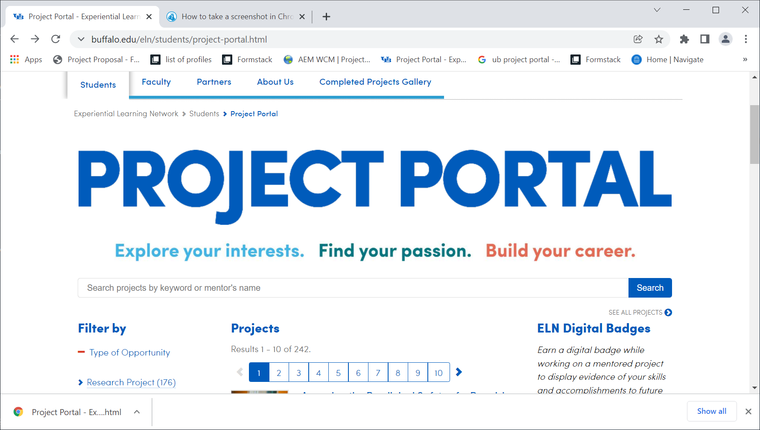
ELN PROJECT PORTAL: HOW IT WORKS
Projects are submitted by faculty, staff, students or partners and must be:
Mentored
Collaborative
Result in some meaningful
outcome
Students can browse existing
Projects or create their own

Slide 7
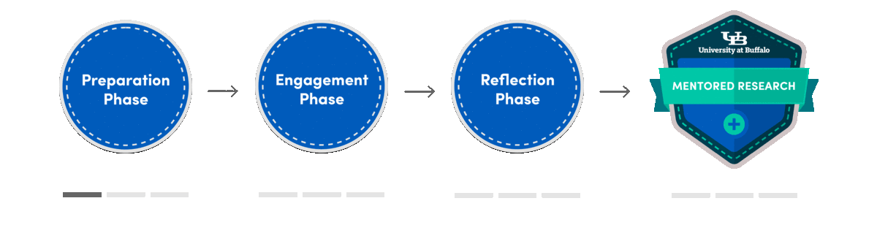
STUDENTS MOVE THROUGH PEARL FRAMEWORK:
Prepare Engage & Add Reflect &
value Leverage
Scalable model works across project types and curricular contexts (curricular & co-curricular)

Slide 8


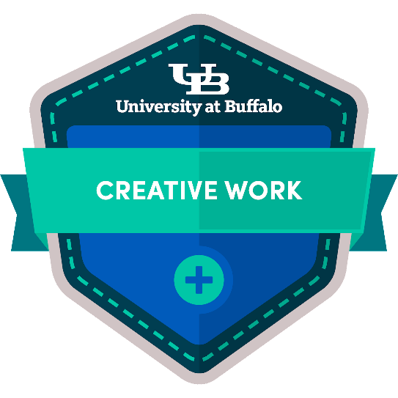
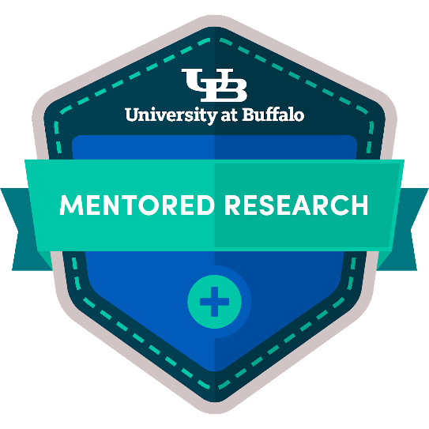
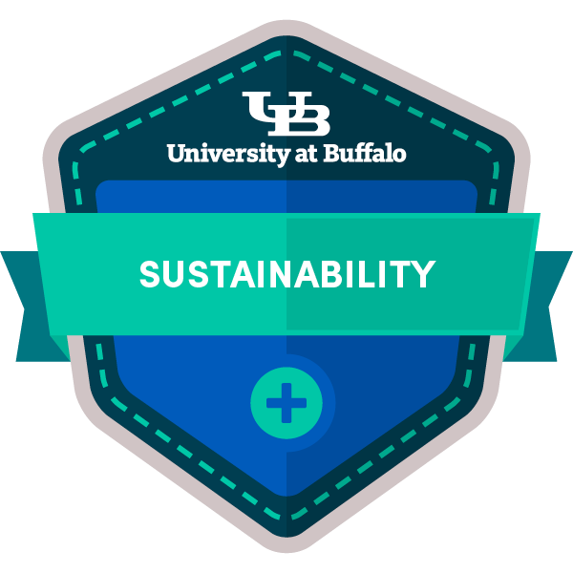
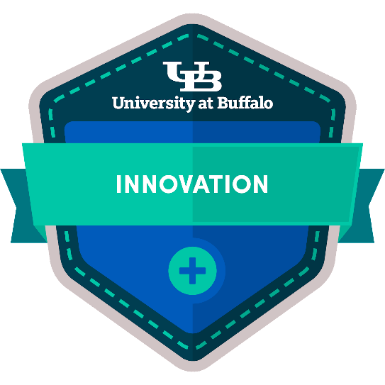
FINAL PROJECTS ARE LINKED TO DIGITAL BADGES
Students can showcase and exchange their experiences
We can track engagement and professional outcomes

Slide 9
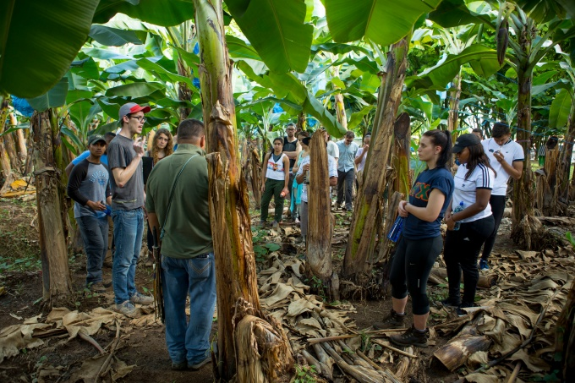
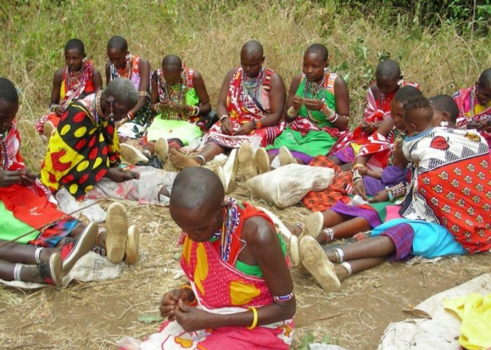

COLLABORATING WITH THE WORLD
Students browse profiles of global NGOs
Prepare: Explore SDGs & contextualize work of the NGO
E & A: Customize a project that adds value while aligning
with student’s interests and goals
R: Integrate project with coursework and professional goals
L Projects and collaboration continue to evolve

Slide 10
OUR MODEL ALSO SUPPORTS TRADITIONAL PRIORITIES & METRICSRESOURCEALENT IS A RENEWABLE RESOURCE
Since launching Portal in 2019, over 1,000 students have engaged, revealing:
Growth in NACE competencies
Student success (relative to matched samples)
Enhanced retention (relative to matched samples)
Insights into engagement
Also benefits for faculty and institutions
Project development
Integration of badges within courses
Recruitment for minors and special initiatives
Grants and funding, external engagement

Slide 11
INTEREST IN EXPANDING AND DEEPENING MODEL
We have more NGO partners than we can match with students. There are opportunities everywhere.
Mara B. Huber
mbhuber@buffalo.edu

