Slide 1
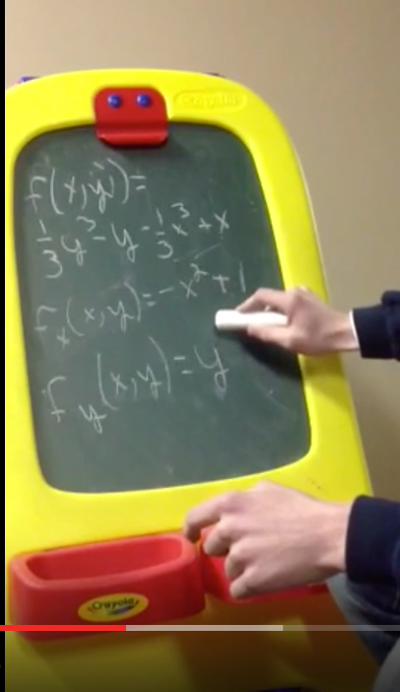
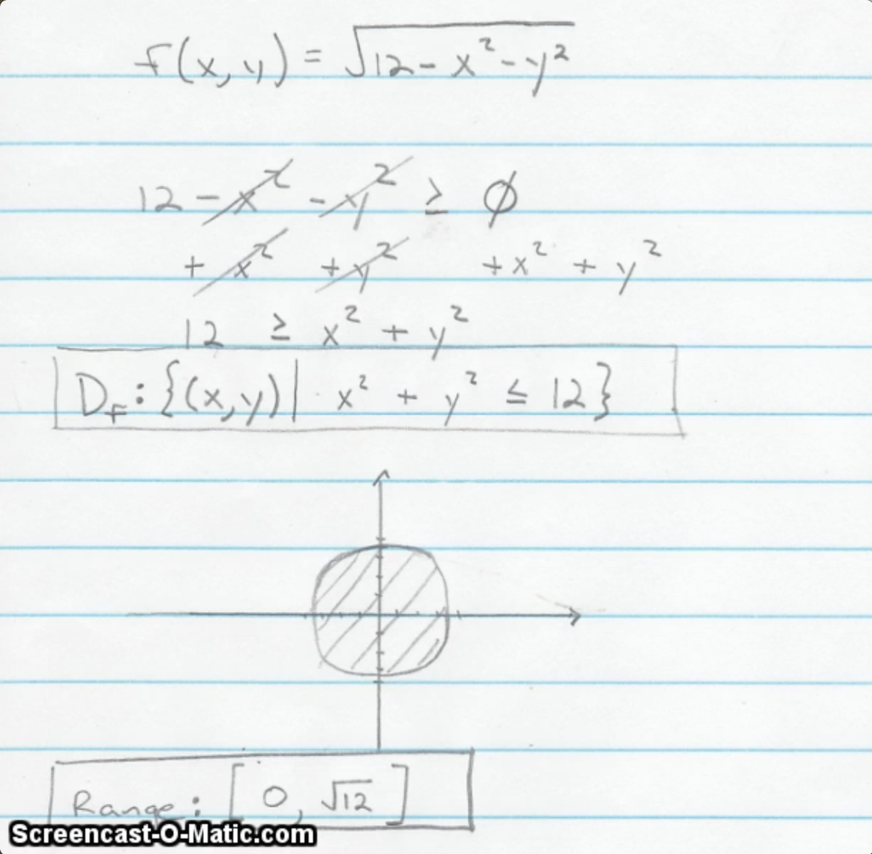
Student Video Problem Presentations as Review Activities in Differential Equations and Multivariable Calculus
by Paul Seeburger of Monroe Community College, Rochester, NY

Slide 2
Since Spring 2013 I have taught the following courses online:
  Multivariable Calculus 6 times
  Differential Equations 1 time (Fall 2015)
I require students to create multiple 3-5 minutes videos of themselves presenting a problem from the course in each of these courses.
  Multivariable Calculus requires students to post 2 videos.
  Differential Equations requires students to post 4 videos.

Slide 3
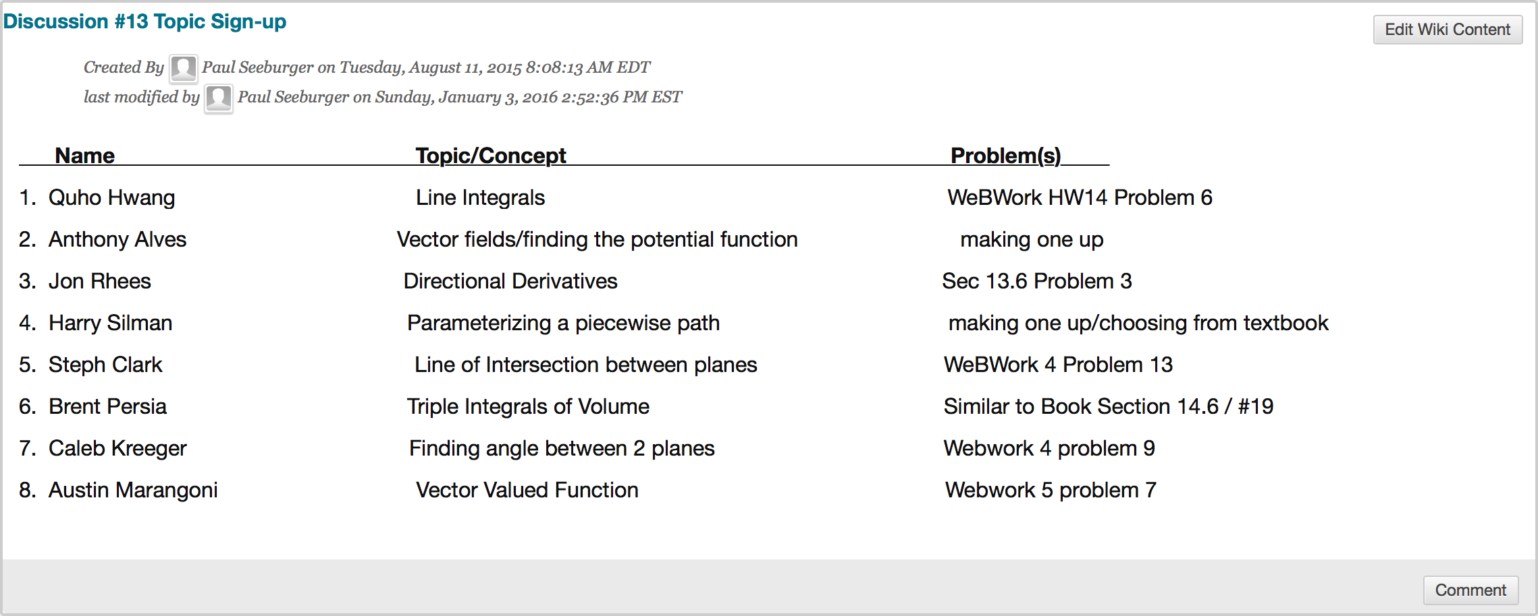
For each of these Video Presentation discussion posts, students use a course wiki to post their topic and specific exercises they plan to present a few days before the video post is due.
This helps me oversee the spread of the topics and be sure there is more variety rather than multiple students choosing the easiest topic.
Student
Names

Slide 4
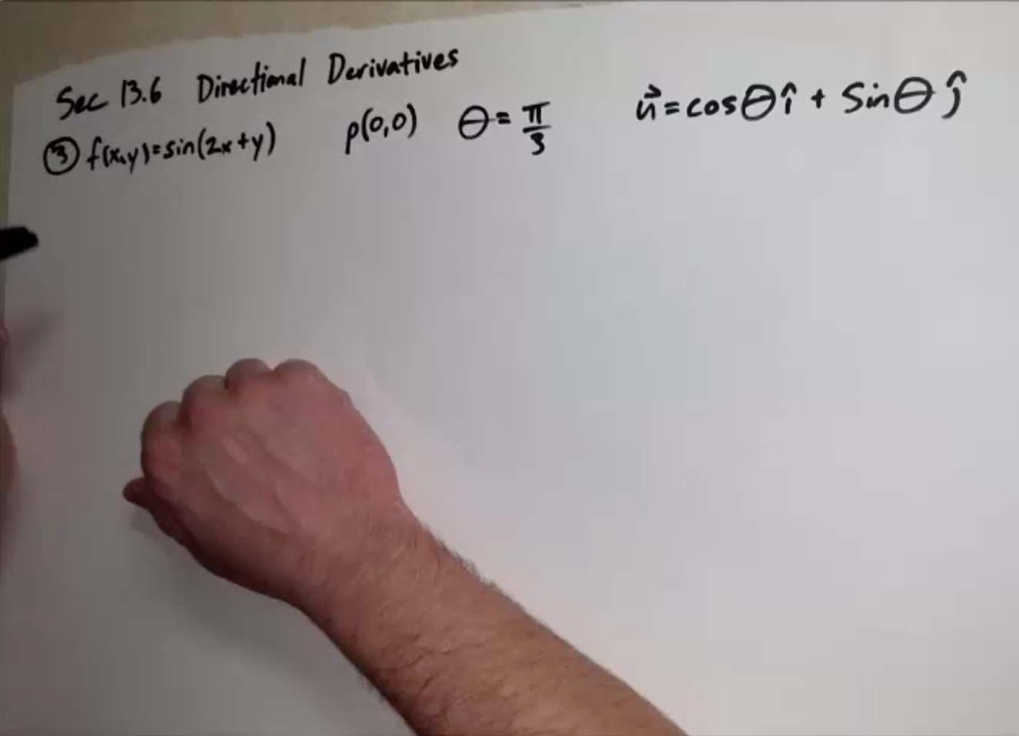
Although I was initially afraid students would find these video assignments too challenging, they have instead claimed these videos are an incredible asset to the course.
Here is an example image of a student video:

Slide 5
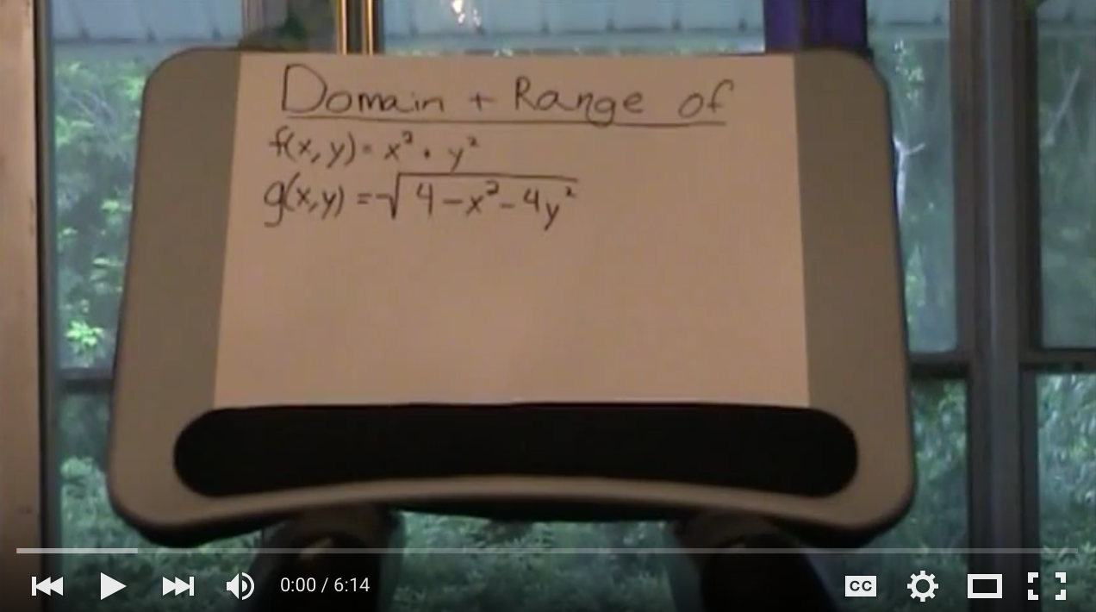
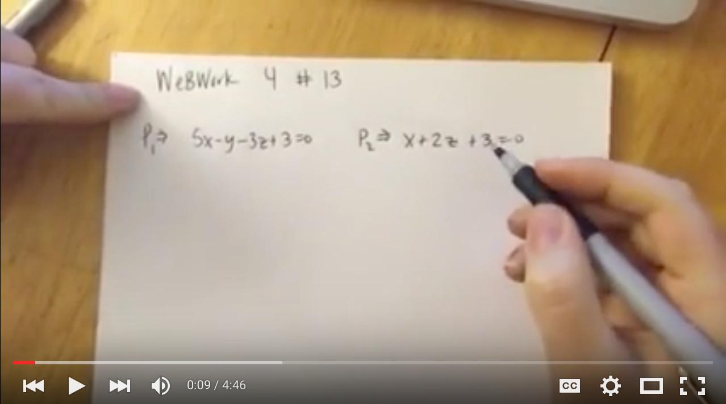
These video assignments are always required to be posted to a Discussion Forum as review for a Unit Exam or the Final Exam.

Slide 6
These video assignments are always required to be posted to a Discussion Forum as review for a Unit Exam or the Final Exam.
Students are required to explain how to work the problem step-by-step from start to finish.

Slide 7
These video assignments are always required to be posted to a Discussion Forum as review for a Unit Exam or the Final Exam.
Students are required to explain how to work the problem step-by-step from start to finish.
They are given bonus points for writing it out clearly as they go or for a particularly clear and helpful video presentation. Visual verification of the result using a graphing applet is encouraged.

Slide 8
These video assignments are always required to be posted to a Discussion Forum as review for a Unit Exam or the Final Exam.
Students are required to explain how to work the problem step-by-step from start to finish.
They are given bonus points for writing it out clearly as they go or for a particularly clear and helpful video presentation. Visual verification of the result using a graphing applet is encouraged.
Problems can be chosen for the videos from the assigned textbook problems, from WeBWorK problem sets, or the student can create their own problem.

Slide 9
These video assignments are always required to be posted to a Discussion Forum as review for a Unit Exam or the Final Exam.
Students are required to explain how to work the problem step-by-step from start to finish.
They are given bonus points for writing it out clearly as they go or for a particularly clear and helpful video presentation. Visual verification of the result using a graphing applet is encouraged.
Problems can be chosen for the videos from the assigned textbook problems, from WeBWorK problem sets, or the student can create their own problem.
Students are required to watch and respond to at least two of their classmates’ video posts for each of these review discussions. Good students will watch and respond to most of them.

Slide 10
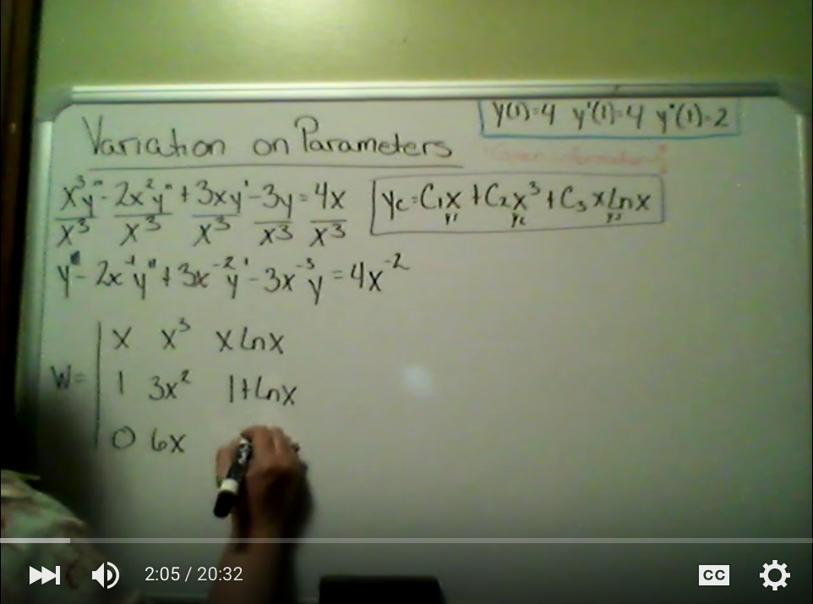
Benefits of these Student Review Videos:
Students master at least the topics they present. It increases their confidence on this material since they have taught the problem to others.

Slide 11
Benefits of these Student Review Videos:
Students master at least the topics they present. It increases their confidence on this material since they have taught the problem to others.
It’s more interesting to listen to fellow students present review examples than to watch more professor-made review videos.

Slide 12
Benefits of these Student Review Videos:
Students master at least the topics they present. It increases their confidence on this material since they have taught the problem to others.
It’s more interesting to listen to fellow students present review examples than to watch more professor-made review videos.
Students get to know each other in a way that is not possible through other interactions in the online course.

Slide 13
Benefits of these Student Review Videos:
Students master at least the topics they present. It increases their confidence on this material since they have taught the problem to others.
It’s more interesting to listen to fellow students present review examples than to watch more professor-made review videos.
Students get to know each other in a way that is not possible through other interactions in the online course.
As the professor, I also get to know my students in a much more personal way through these videos.

Slide 14
Benefits of these Student Review Videos:
Students master at least the topics they present. It increases their confidence on this material since they have taught the problem to others.
It’s more interesting to listen to fellow students present review examples than to watch more professor-made review videos.
Students get to know each other in a way that is not possible through other interactions in the online course.
As the professor, I also get to know my students in a much more personal way through these videos.
Often I find some student videos that I can make available for supplementary video solutions in future semesters of these online courses (with the student’s permission, of course).

Slide 15
Disadvantage of Requiring Student Review Videos:
They take more time to grade than regular homework.
  Some students get carried away and present two or three problems and/or make their videos 10 - 30 minutes long.
  I try to post corrections or clarifications to each posted video before the upcoming relevant exam, while trying to wait on these until students have had a chance to post some of these clarifications or corrections themselves.

Slide 16
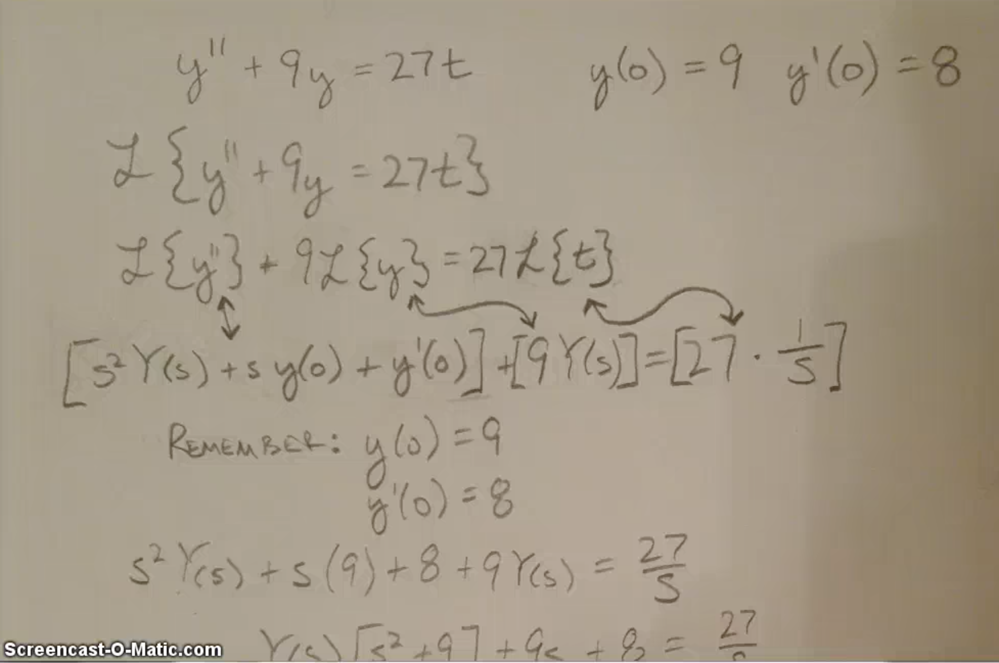
A Student Video problem from Differential Equations:

Slide 17
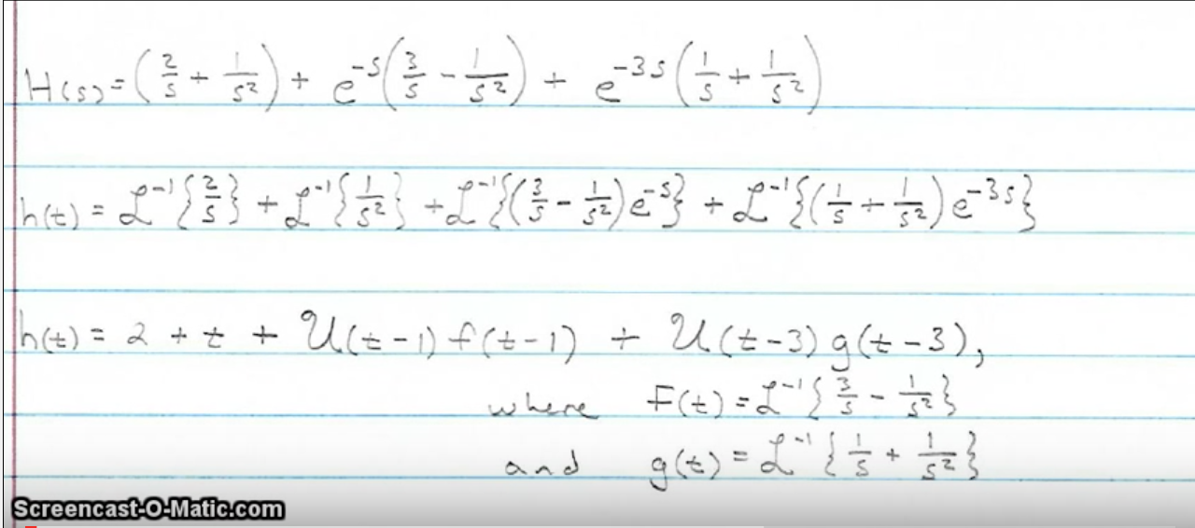
A Student Video problem from Differential Equations:

Slide 18
A Student Video problem from Multivariable Calculus:

Slide 19
Student Comments on these Video Assignments:
  “They are definitely helpful and make it easier to recall the subject during the test.”
  “I really enjoy making the example videos. I think it really promotes understanding of a topic, and I think it is good to "interact" with our class mates. I also find them to be very helpful study tools, sometimes bringing up a topic I have all but forgotten about.”
  “The video example discussions were helpful. I like that they're timed as such to be a couple of weeks before the exam, and they force me to start looking back through the material early. In choosing topics that I've struggled with to present on the video discussion, I've been able to go into exams feeling really well prepared since I started studying the tough stuff early.”

Slide 20
Student Comments on these Video Assignments:
  “Yes! Video discussion assignments are awesome! There's a lot of pressure because I hate making mistakes, but it's honestly far more informative if we do. Reading comments on a mistake on a written assignment is easy-peasy; I wish I were in a classroom where we were required to go up to the board and work out the problems, and people were generally enthusiastic about it and making mistakes.”
  “They solidified the material alot, much appreciated!”
  “I enjoyed the opportunity to post some review for my peers. To teach something is to master it, so it forced me to know a topic inside and out so that I could explain it well. That helped me a lot for the exam. I was also really glad to watch the other videos. It was great to see some topics that were difficult for me, explained in a different way. Those videos were so helpful for me when taking the second exam. ”

Slide 21
Student Comments on these Video Assignments:
  “The video example discussion assignment was good because we got out chance to solve a problem and share it with other student, all while getting their feedback. Also, since everyone had to choose different concepts, a wide range of topics were covered.”
  “The video example discussion assignment was a little uncomfortable but forcing yourself to teach others makes sure that you know it yourself.
  ("If you can't explain it simply, you don't understand it well enough."~ Albert Einstein)”
  “The videos example discussion assignment was very helpful. At first glance the video assignment seemed like it was going to be long, and difficult, but it turned out to be one of the easier assignments. And it was especially helpful in preparing for the following exam. I aced every question related to my topic that I chose.”

Slide 22
Other Discussion Topics I Use in These Online Courses:
  Asking a math question and answering at least 1 classmate’s question.
  Describe something significant you learned/understood/figured out from the material covered in the past Unit.
  What is the most interesting topic or application we've studied in this course so far? Maybe it seemed to apply to the real-world in a cool way, or maybe you just found it mathematically beautiful.
  Class Feedback, addressing a series of specific questions.
Multivariable Calculus Specific Discussions:
  Describe an application of the Dot and/or Cross Product other than those described in this course.
  Post a favorite function of 2 variables along with its Contour Plot.
  Share something you learned from the 3 Visual Concept Explorations.
A Differential Equations Specific Discussion:
    Clearly describe an application of an ordinary first-order differential equation in another subject or context than has been described or done in our course so far.

Slide 23
Thank You!
If you would like more information on my video discussion assignments, please email me at: pseeburger@monroecc.edu

