Slide 1

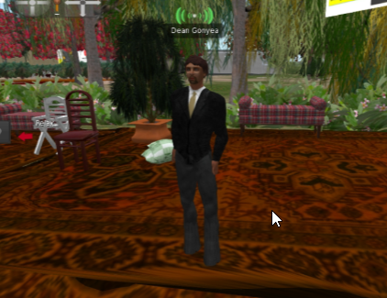
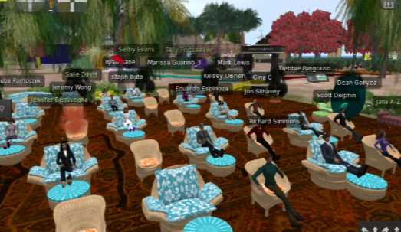
Dean Gonyea launched the Immersive VR/AR Residency
The School of Graduate Study’s strategic plan includes the use of innovation in teaching
Alumni, students, faculty and guests joined the residency all-day event dedicated to the experience of augment and virtual reality

Slide 2
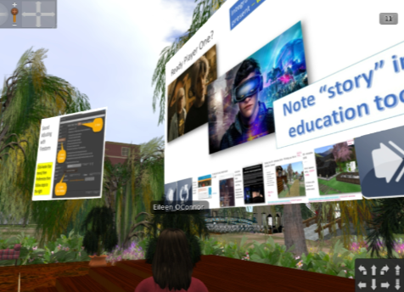
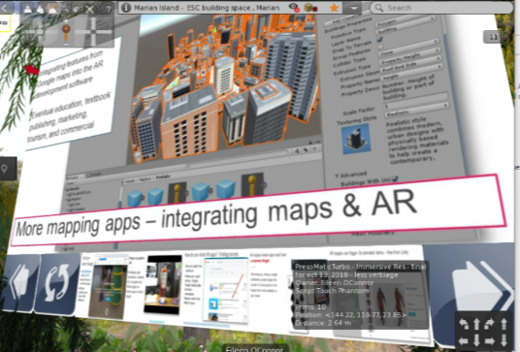
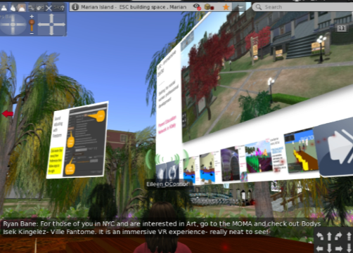
The raised platform created a Ted-TALK-like environment for Dr. O’Connor overview
Ideas and images were presented about the growing use of augmented and virtual reality. Students interacted through the chat; video links were shared through the chat as well.

Slide 3
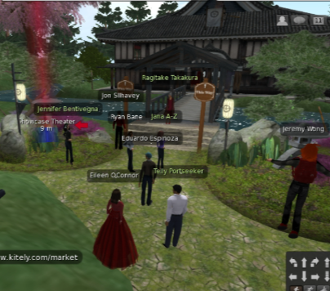
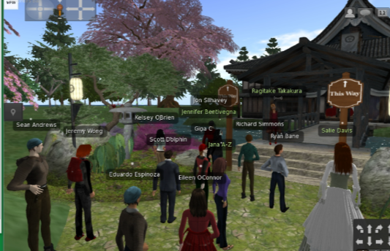
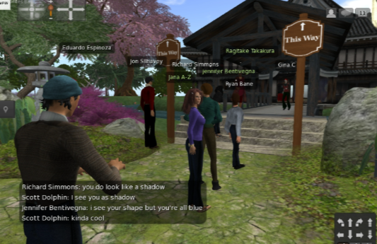
Participants Joined a walking tour of several virtual reality islands

Slide 4
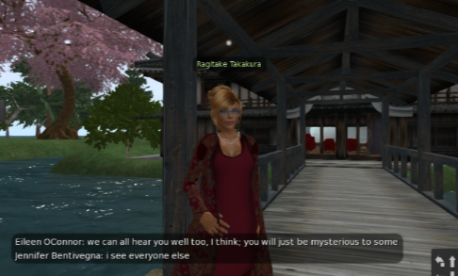
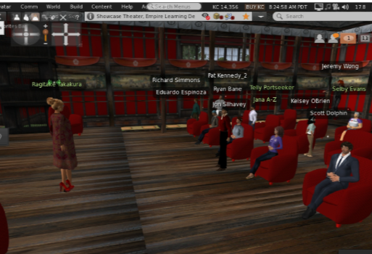
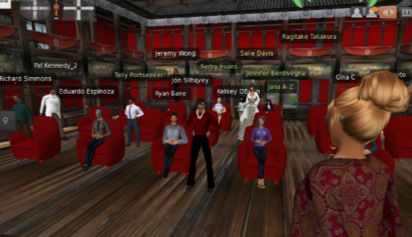
Dr. Allain Addressed virtual design considerations

Slide 5
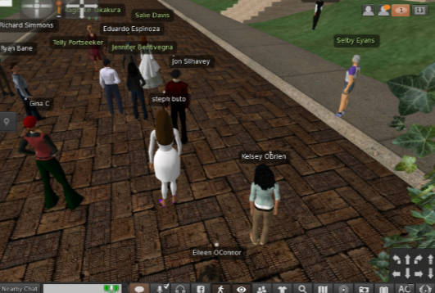
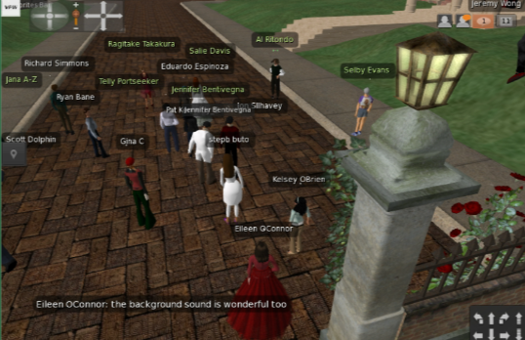
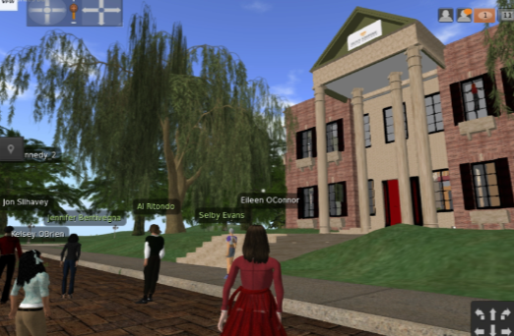
Tours continued on Dr. Allain’s Island

Slide 6
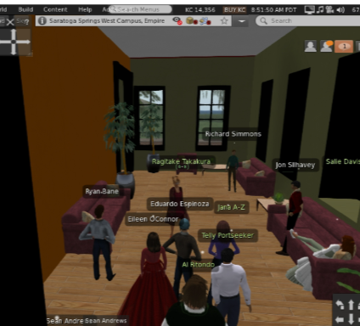
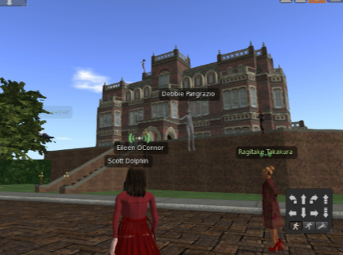
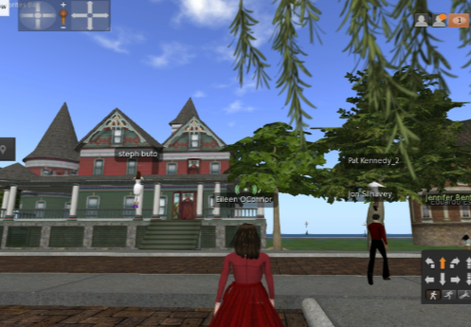
some buildings are unique While others suggest ESC’s Saratoga campus
Buildings and environments can be developed, gathered from Creative Commons art collections, and/or purchased at reasonable fees

Slide 7
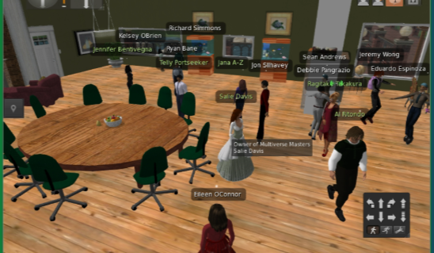
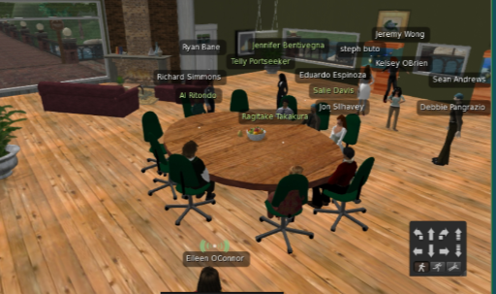
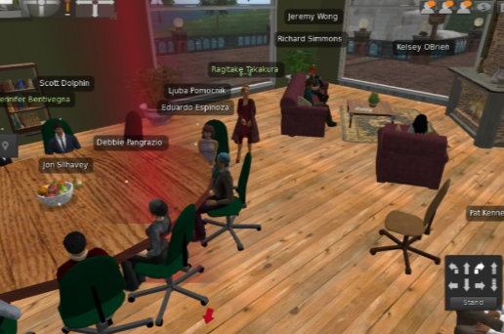
Participants learning basics of virtual building

Slide 8
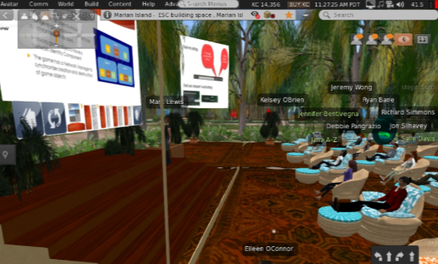
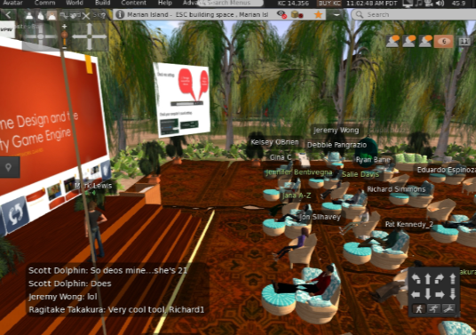
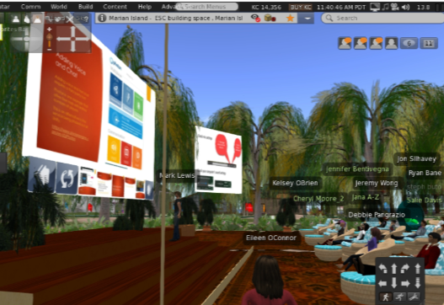
The day concluded with Mark Lewis’ overview of game design

